Slide 1

Welcome to all

Slide 2
Placements[JOBS]
Active Income
Passive Income
Royalty Income
Monthly Income
One Time Income
Life time Income
Company Jobs
Cyber Sec / Freelancer
Royalty[Website Traffic]
Company Jobs/Startups
Bounty
Make New IT Product

Slide 3
Learning & Development with IT
Revenue Based[Designation]
Problem solving Skills[Programming]
Software Developing[PHP,ASP, SPRING,Django..]
Cyber Sec / Pen tester[Linux, PYTHON]
Data Analyst/Data scientist[BIGDATA/R/NOSQL]
BLOCKCHAIN Developer

Slide 4
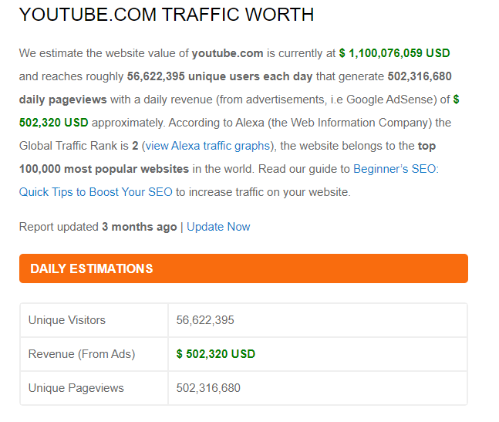

Slide 5
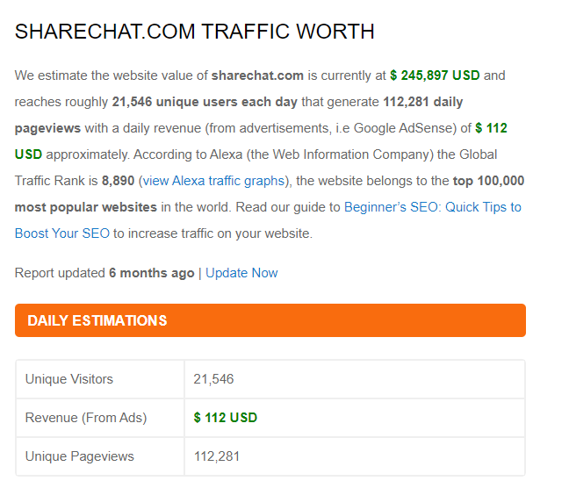

Slide 6
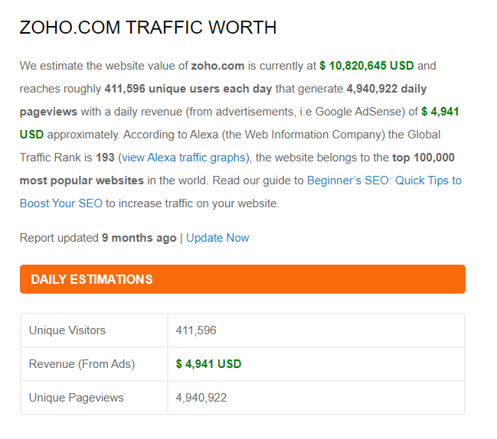

Slide 7
Making Traffic
120 Cr - Total Users(app)
5 Cr[Youtube] – Daily Users
5% people only using Youtube
Target:[User-friendly UI / Helping Mind]
50K users daily
0.05% Global Population

Slide 8
Problem solving skills[leet code]
Algorithm & Flow
Loops & Nested
Function
Arrays
Oops
Strings
Database
System Design
Data structure
MAANG COMPANIES
3000+ tech companies

Slide 9
Server & cloud[GITHUB] 50K – 50L
Front End
Backend[SQL,NOSQL]
Core Application
Apps Using API
Manual Testing
Deployment
Framework Install
Framework Apps
Basic CRUD
Deployment
API Access
Cloud Storage
Min Security [5 attacks]

Slide 10
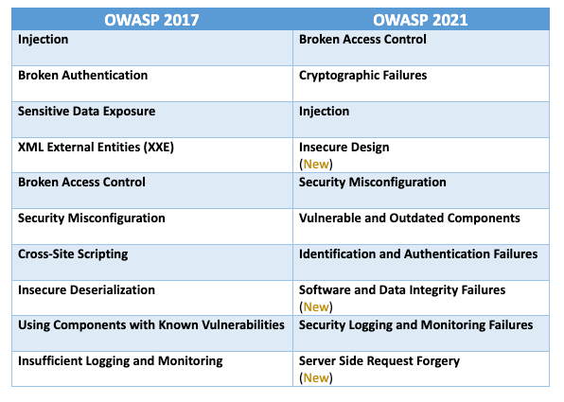
Cyber Security[Testing]

Slide 11
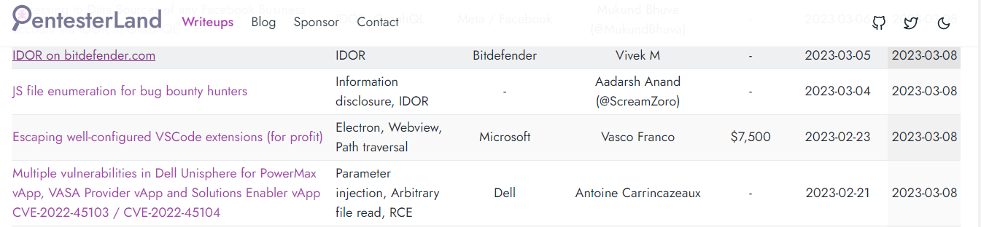
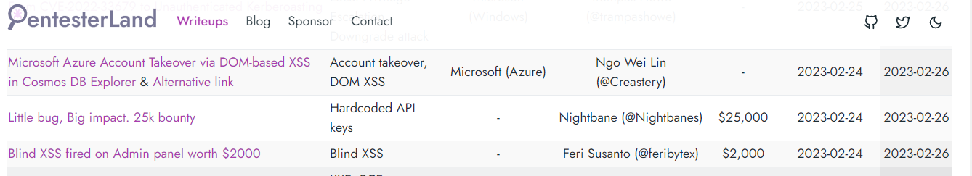
Cyber Sec

Slide 12
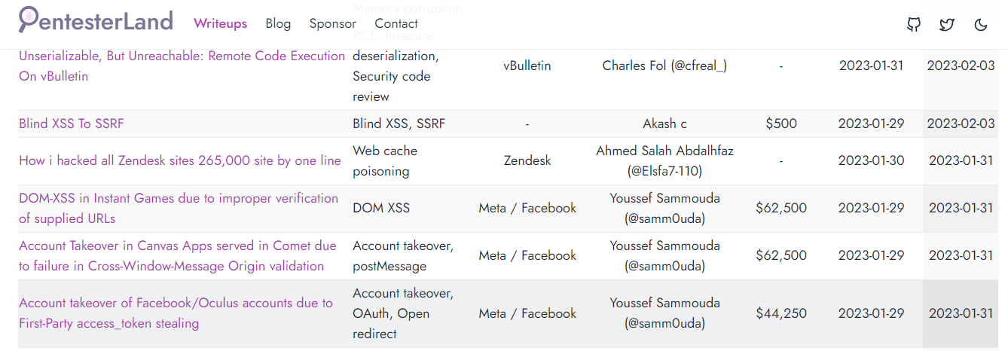
Cyber Sec

Slide 13
Big Data
SQL
NOSQL
JSON
Power BI
R proggramming
Python
ML
etc..
https://www.kaggle.com/datasets/mirzahasnine/loan-data-set

Slide 14
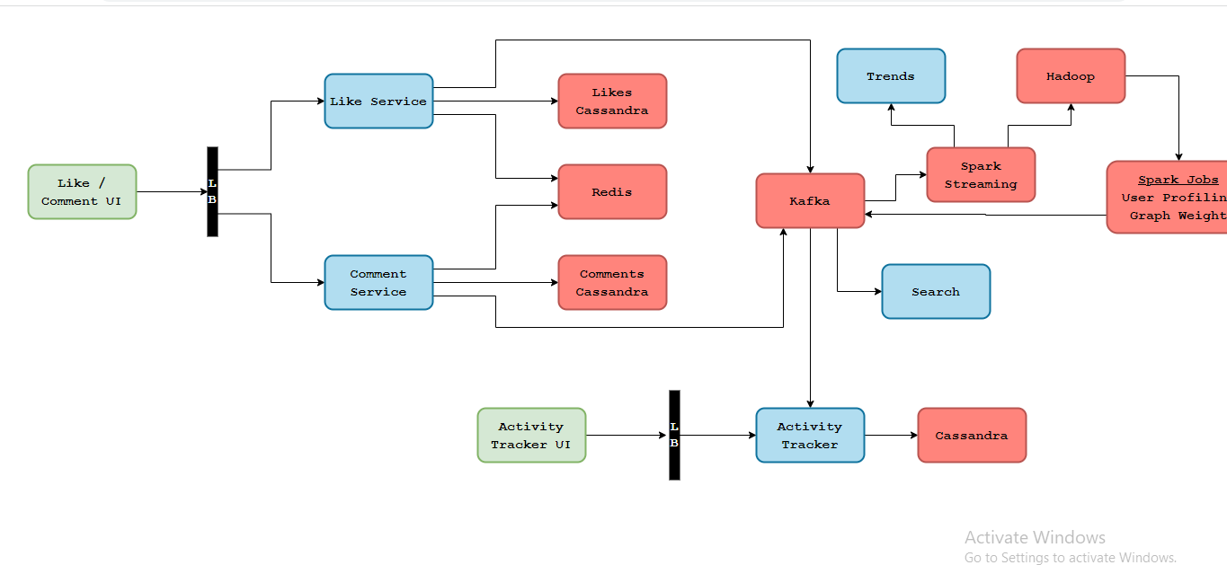
Big Data [Face book SYSTEM Design]

Slide 15
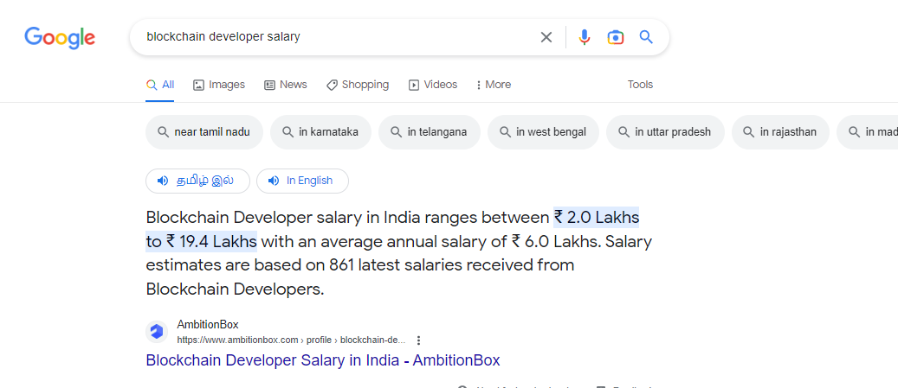
Cloud & Block Chain[Dapps]

Slide 16
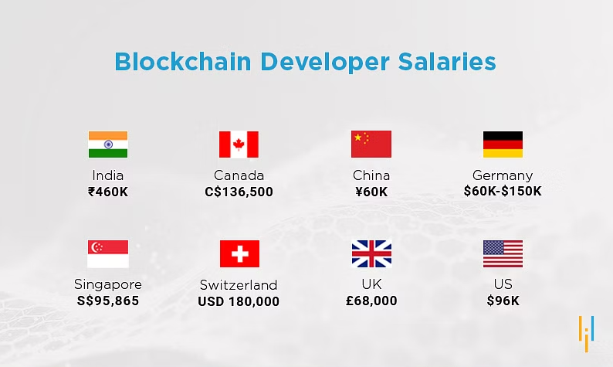

Slide 17
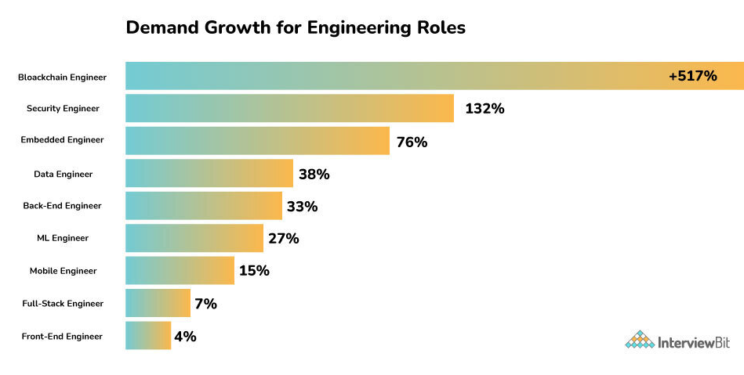
Blockchain Developer

